Slide 1
English
Unit 1 – My World
WALT: Understand, with support, most specific information and detail of short and extended talk.

Slide 2



WALT: Understand, with support, most specific information and detail of short and extended talk.
With support, I can understand details of a talk about emotional reactions.
I can independently understand details of a talk about emotional reactions.
I can review specific vocabulary from a talk and explain what it means.

Slide 3
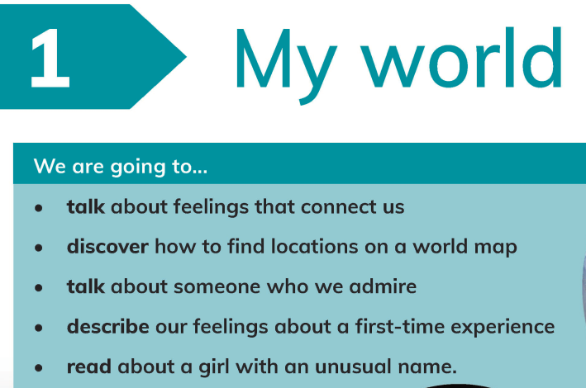
Starter
WALT: Understand, with support, most specific information and detail of short and extended talk.
Which part of this unit are you looking forward to the most?
Which do you think might be the most challenging?

Slide 4

Look at these pictures. Which emotion would you associate with each picture?
WALT: Understand, with support, most specific information and detail of short and extended talk.

Slide 5

Listen to the boy talk about how he has been feeling.
WALT: Understand, with support, most specific information and detail of short and extended talk.
1. How did Leo feel right before he started his presentation?
2. Which word from the text means to feel happy because of your own success or achievement?
3. Why did Leo's parents buy him pizza in the evening?
4. What physical sign showed that Leo was nervous at the beginning?

Slide 6
WALT: Understand, with support, most specific information and detail of short and extended talk.
1. Before he started his speech, Leo felt incredibly nervous. He thought he would forget his lines.
2. The word which makes you feel happy because of your own success or achievement is proud.
3. Leo’s parents bought him pizza because he did an excellent job.
4. Leo’s hands were shaking. This is a sign he was nervous.

Slide 7
Now, listen to the girl talk about how she has been feeling.
WALT: Understand, with support, most specific information and detail of short and extended talk.
1. Why did Hollie feel overwhelmed at the start of the day?
A) She forgot her homework.
B) The school was very big and she knew nobody.
C) She lost her lunchbox.
2. True or false. Hollie spent the entire school day feeling sad and sitting by herself.
3. How did Sarah’s behaviour change Hollie’s feelings by the afternoon?

Slide 8
WALT: Understand, with support, most specific information and detail of short and extended talk.
1. B.
2. False.
3. When Sarah came to sit with Hollie, she felt hopeful. She thought she might actually make friends in this new city.

Slide 9
In the talk you’ve just listened to, Hollie felt overwhelmed.
WALT: Understand, with support, most specific information and detail of short and extended talk.
What does it mean to feel overwhelmed?
Overwhelmed is when your brain and body feel a heavy load because there are too many demands, thoughts, or feelings to handle at once.
Have you ever felt overwhelmed? What did you do to calm down?

Slide 10
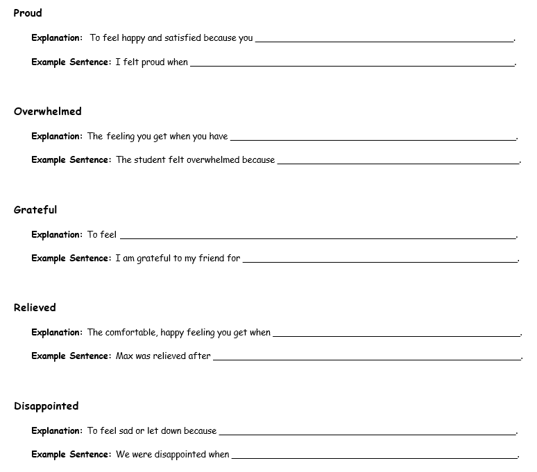
WALT: Understand, with support, most specific information and detail of short and extended talk.

Slide 11
WALT: Understand, with support, most specific information and detail of short and extended talk.
With support, I can understand details of a talk about emotional reactions.
I can independently understand details of a talk about emotional reactions.
I can review specific vocabulary from a talk and explain what it means.

